Slide 1
The solutions to the three main menaces of information security
A machine learning approach to
spam mails, spywares and
web intrusion detections
Prof. Shi-Jinn Horng
Taiwan Information Security Center
National United University
National Taiwan University of Science and Tech.
115/11/08

Slide 2
Outline
Introduction
(The threats to information security and some solutions)
A Brief View of Support Vector Machine
Intrusion Detection System for Web Server Based on Support Vector Machine
Spam Filtering System with Security Mechanism
Surveillance Spyware Detection System
Conclusions
115/11/08
Department of Computer Science and Information Engineering

Slide 3
Security Issues
Nowadays, network has not only played an important role to make our life more convenience but also became a essential part of our life.
It is hard to image how to live without email, websites and useful packages (Offices).
Advantages are accompanied by disadvantages. Website intrusion, spam, and spyware are serious security issues we need to face and overcome.
115/11/08
Department of Computer Science and Information Engineering

Slide 4
Website Intrusion
Intrusion is an unauthorized access to a computer system or network.
Since serving users is the goal of any web site, its public properties and vulnerability are always the targets of attacks.
Even like Yahoo, such a famous website had been intruded in 2000, and the loss is hard to evaluate.
115/11/08
Department of Computer Science and Information Engineering

Slide 5
Website Intrusion (cont.)
Generally, IDS (Intrusion Detection System) is a choice to protect the website from intrusions. Snort [1], the rule-based IDS, is a well known rule-based IDS.
Although rule-based IDS has high performance on detecting rate and less time consumption, a fatal disadvantage of it is unable to detect unknown or novel intrusion activities.
115/11/08
Department of Computer Science and Information Engineering

Slide 6
Website Intrusion (cont.)
In academia, there are many researches about constructing an IDS.
For example, the research about the techniques of clustering [2] and Neural Network [3] to make the IDS more competent to fightback the unknown intrusion activities.
In our study, we use the new data mining method called SVM (support vector machine) to construct our IDS.
115/11/08
Department of Computer Science and Information Engineering

Slide 7
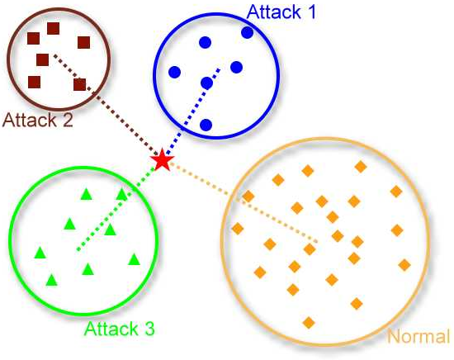
Clustering
115/11/08
Department of Computer Science and Information Engineering

Slide 8
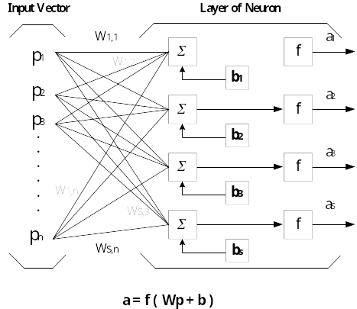
Neural Network
115/11/08
Department of Computer Science and Information Engineering

Slide 9
Spam
In general, Spam indicates the practice of sending massive amounts of unsolicited e-mail promotions or advertisements to people that have not asked for it.
According to the technique report of the Radicati Group [4], the cost of business was exhausted by spam amount 205 billion dollars per year.
115/11/08
Department of Computer Science and Information Engineering

Slide 10
Spam (cont.)
The number of spam messages received is continually increasing exponentially [5] and the percentage of spam messages sent per day will increase 49% of messages in 2005, to 78% in 2009.
Revenues in the email security appliances segment will increase from $387 million in 2005, to $1,516 million in 2009.
115/11/08
Department of Computer Science and Information Engineering

Slide 11
Spam (cont.)
In the recent years, many methods have been proposed to filter out the spam e-mails.
TF-IDF weighting and rule learning [6], Naïve Bayesian [7], Neural Networks [8].
In our research, we also adopt the SVM to design the spam filter embedded in our e-mail client system.
115/11/08
Department of Computer Science and Information Engineering
Notes:
TF-IDF weighting and rule learning [7], Naïve Bayesian [8], Neural Networks [9], Memory-Based [10], Boosting Tree [11].
作法

Slide 12
TF-IDF Weighting
The tf-idf weight (term frequency - inverse document frequency) is a weight often used in Information Retrieval.
The term frequency in the given document gives a measure of the importance of the term within the particular document.
The document frequency is a measure of the general importance of the term.
115/11/08
Department of Computer Science and Information Engineering

Slide 13


TF-IDF Weighting
with n_{i} the number of occurrences of the considered term, and the denominator is the number of occurrences of all terms.
|D| : total number of document in the corpus
number of documents where the term tj appears.
A high weight in tf-idf is reached by a high term frequency (in the given document) and a low document frequency of the term in the whole collection of documents; the weights hence tends to filter out common terms.
115/11/08
Department of Computer Science and Information Engineering

Slide 14
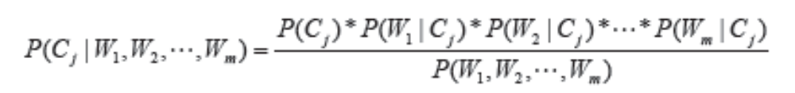
Naïve Bayesian
ci means the classes of documents (there are only spam and legal emails)
wi means the key words in a document.
115/11/08
Department of Computer Science and Information Engineering

Slide 15
Spyware
Spyware is a software placed on the user' s machine to transmit information back to a third party without users' knowledge or permission.
Spyware will record information, including
  Web surfing habits
  Keystrokes
  Accounts & Passwords
  Important documents & Trade secrets
It works potentially, uses the system resources and bandwidth as it tracks and transmits information.
115/11/08
Department of Computer Science and Information Engineering
Notes:
1.紀錄網路瀏覽習慣，藉以傳送相關的廣告或是將我們的browser導向其網站等等
2. 郵件，寄發垃圾信
3. 鍵盤紀錄，類似竊聽的功能。EX：張錫銘
4. 電腦帳號密碼、銀行帳號、信用卡帳號、身分證字號等等
5. FTP：技術文件，商業機密，人事資料。EX：外交部
6. 利用遠端遙控，spyware可以取得管理者權限，因此可以做任何想做的事。
7.Spyware對系統的為害：耗用系統資源(CPU, Memory) ，形成新的漏洞等等

Slide 16
Spyware (cont.)
Some statistics [9] show that spyware infects an estimated 90% of Internet-connected computers.
They also found that nearly one in three computers was infected with the surveillance spyware like Trojan horse or system monitor.
115/11/08
Department of Computer Science and Information Engineering
Notes:
1. According to the report from EarthLink Inc., a major Internet service provider, of scanning 1.5 million computers during Jan. 1 to April 30, 2004 found that there were approximately 41 million traces of spyware programs or components.

Slide 17
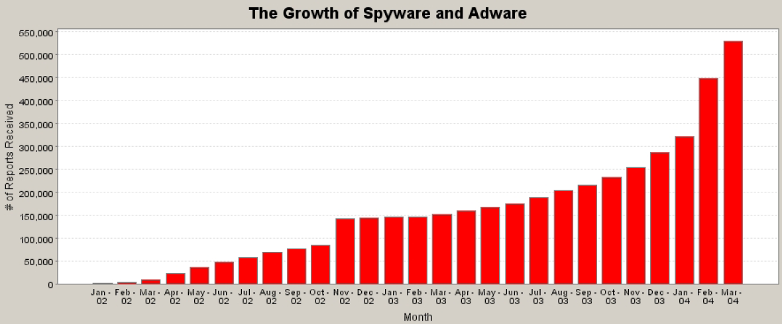
Spyware [10] (cont.)
115/11/08
Department of Computer Science and Information Engineering

Slide 18
Spyware (cont.)
The sloppy spyware program will cause the infected user’s computer to slow down or crash easily.
Moreover, it may bring new security vulnerabilities which could be exploited by the malicious hackers to intrude and launch other kinds of attacks such as DDoS attack.
115/11/08
Department of Computer Science and Information Engineering

Slide 19
Few efforts to oppose spyware
The problem of spyware is incredibly serious than anyone’s image. Some famous anti-virus software vendors had entered the spyware-detection field from 2003.
But there were not many research papers [11] about spyware published until now.
115/11/08
Department of Computer Science and Information Engineering

Slide 20
Few efforts to oppose spyware
For overcoming the lacks of usual anti-spyware products, we combine the methods of static and dynamic analysis to extracting features from spyware programs and integrating with the data mining technologies of information gain and SVM to construct our spyware detection system.
115/11/08
Department of Computer Science and Information Engineering

Slide 21
Outline
Introduction
(The threats to information security and some solutions)
A Brief View of Support Vector Machine
Intrusion Detection System for Web Server Based on Support Vector Machine
Spam Filtering System with Security Mechanism
Surveillance Spyware Detection System
Conclusions
115/11/08
Department of Computer Science and Information Engineering

Slide 22
Data mining
Data mining is the process of autonomously extracting useful information or knowledge from large data stores or sets. It is surely used in many fields such as business managing, marketing, finance, biotechnology, etc.
We use data mining methods to make our security system not only can catch the known attacks, but also able to detect the unknown or novel attack.
The prediction ability should be the important part which can truly protect us away from attacks.
115/11/08
Department of Computer Science and Information Engineering

Slide 23
Support Vector Machine
Support Vector Machine (SVM) was built by Vapnik [12] is a method of machine learning, and is used in pattern classification and regression extensively.
Training vectors : x_{i} , i = 1, . . . , l
Consider a simple case with two classes:
Define a vector y
y_{i} = 1 if x_{i} in class 1
−1 if x_{i} in class 2,
A hyperplane which separates all data
115/11/08
Department of Computer Science and Information Engineering

Slide 24
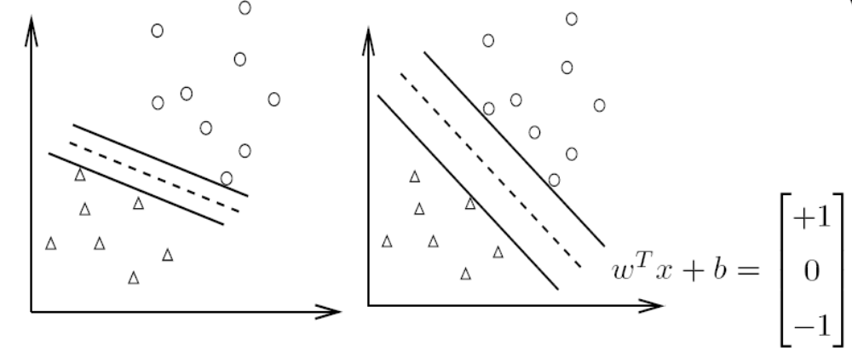
Separating Hyperplane
A separating hyperplane: w^{T} x + b = 0
(w^{T} x_{i}) + b > 0 if y_{i} = 1
(w^{T} x_{i}) + b < 0 if y_{i} = −1
Decision function f(x) = sign(w^{T} x + b), x: test data
Variables: w and b : Need to know coefficients of a plane.
Many possible choices of w and b
115/11/08
Department of Computer Science and Information Engineering
Notes:
SVM推導

Slide 25
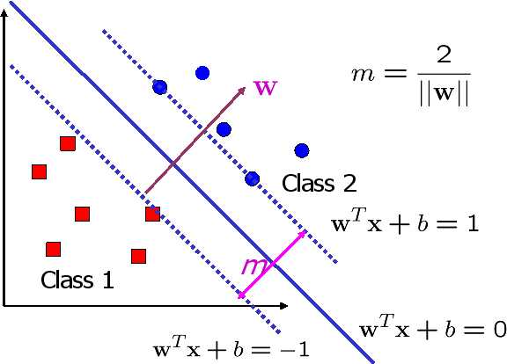

Finding the Decision Boundary
Select w, b with the maximal margin.
Maximal distance between w^{T} x + b = ±1
115/11/08
Department of Computer Science and Information Engineering

Slide 26
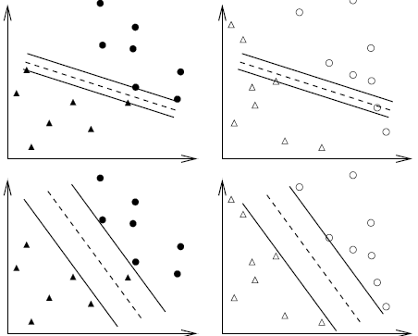
Over fitting
115/11/08
Department of Computer Science and Information Engineering

Slide 27
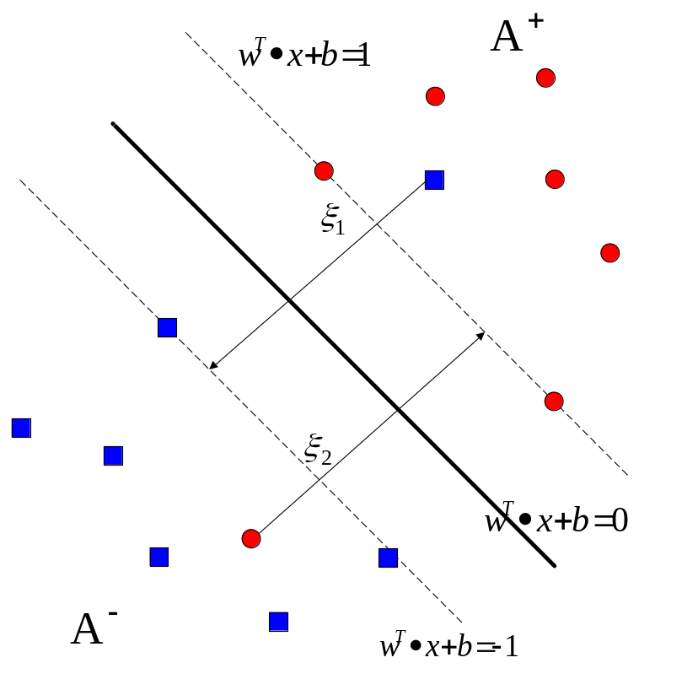
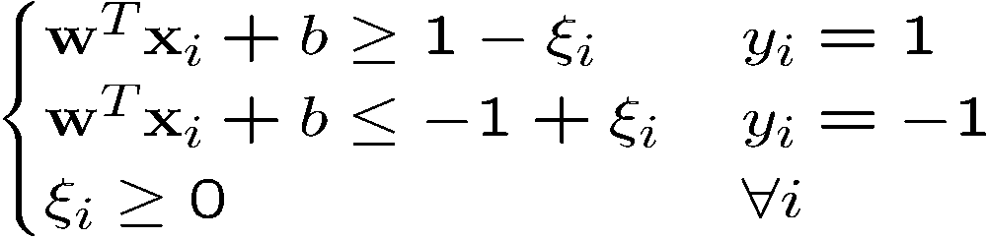
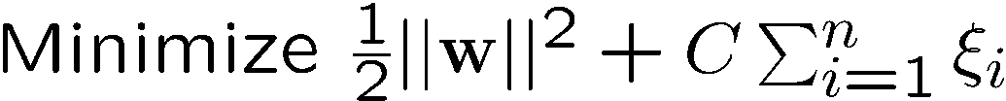
Allow training errors
By minimizing ∑_{i}ξ_{i}, ξ_{i} can be obtained by

ξ_{ι} are “slack variables” in optimization
The optimization problem becomes
C : tradeoff parameter
between error and margin
115/11/08
Department of Computer Science and Information Engineering

Slide 28
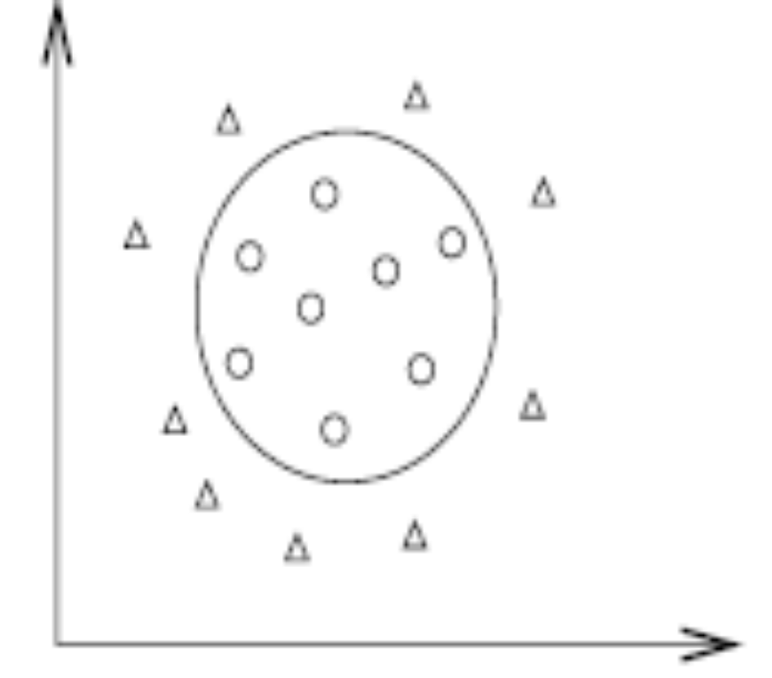
Nonlinear Separable
115/11/08
Department of Computer Science and Information Engineering

Slide 29
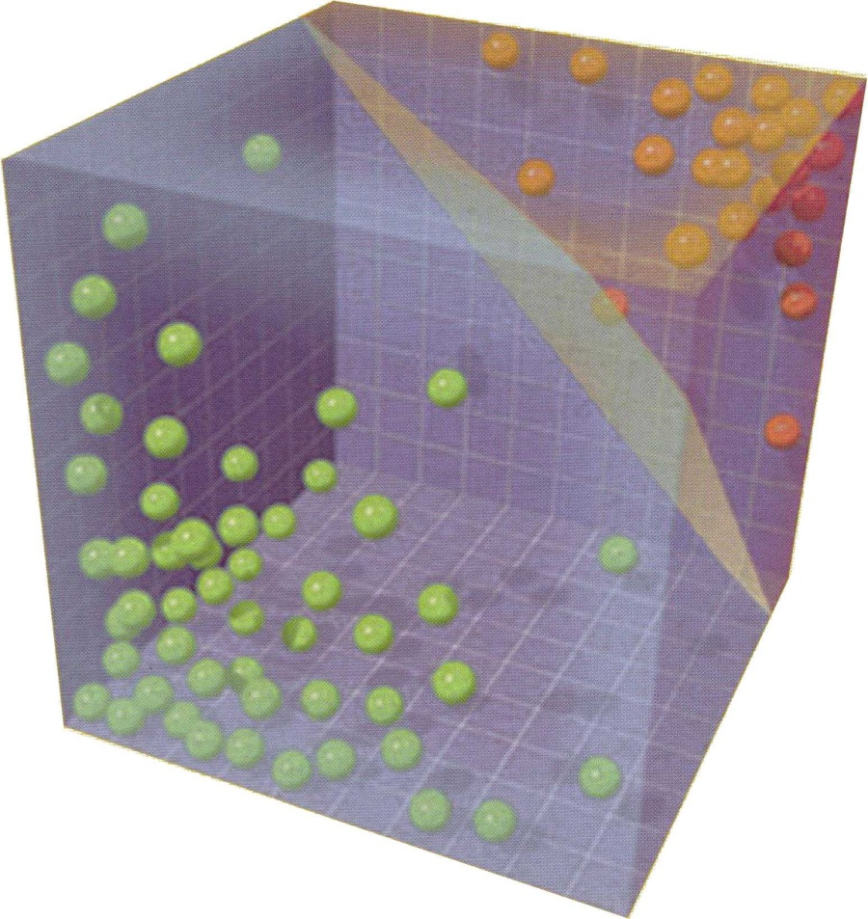
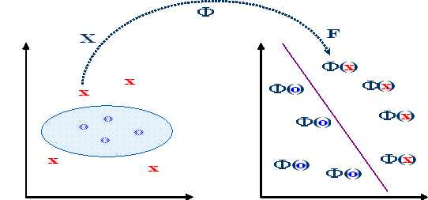
Solutions
115/11/08
Department of Computer Science and Information Engineering

Slide 30
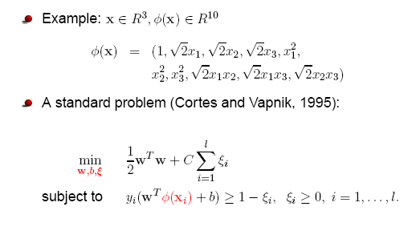
Project to higher dimensional feature space
115/11/08
Department of Computer Science and Information Engineering

Slide 31
SVM on Security
By using SVM to implement the core of our security modules, it leads to lots of advantages.
  Firstly, with the comparison with other traditional classifiers, SVM can decrease training error and testing error at the same time.
115/11/08
Department of Computer Science and Information Engineering

Slide 32
SVM on Security
  Secondly, the SVM classifier has high accuracy in prediction which help us hold up any kinds of new security threats.
  Moreover, SVM has a clear advantage in speed and it consumes less time in testing. It would be totally useless if we can not catch a threat in time. Therefore, speed is one of the most important factors for building a real-time security system.
Therefore, SVM is a suitable solution for building a security system.
115/11/08
Department of Computer Science and Information Engineering

Slide 33
Outline
Introduction
(The threats to information security and some solutions)
A Brief View of Support Vector Machine
Intrusion Detection System for Web Server Based on Support Vector Machine
Spam Filtering System with Security Mechanism
Surveillance Spyware Detection System
Conclusions
115/11/08
Department of Computer Science and Information Engineering

Slide 34
Introduction
According to the report of CERT Coordination Center [13] on September 2004, there are 78 vulnerabilities dedicated to IIS.
In our study, we consider 54 vulnerabilities out of 78, i.e., detecting 54 attacks were divided into five categories as follows.
  Deny of Service
  Unicode vulnerabilities
  Web-based applications vulnerabilities
  CGI abuses
  Miscellaneous
.
115/11/08
Department of Computer Science and Information Engineering

Slide 35
Deny of Service
Attacker can use improper way to make the server crashed or too busy to provide legal access.
For example, request like this GET/XXXXXXXXXXXXXXXXXXXXX…XXX could compromise the server as character “X” was stuffed enough to overflow the buffer. Exhausting buffer is one of DoS attack.
115/11/08
Department of Computer Science and Information Engineering

Slide 36
Unicode vulnerabilities
Attacker can use the URL, for example,
http://192.168.0.1/scripts/..%c1%9c..\winnt\system32\cmd.exe?/c+ipconfig,
to illegally retrieve server’s IP information, such as IP, subnet mask, and gateway addresses.
Since these special characters “%c1%9c” were decoded as “\” by IIS server according to Unicode translation, the attacker would successfully escape default directory and execute the ipconfig command.
115/11/08
Department of Computer Science and Information Engineering

Slide 37
Web-based applications vulnerabilities
There are a lot of applications intending to extend web services, such as ColdFusion, FrontPage, SQL server, ASP, etc. These applications’ holes potentially compromise the security of the IIS server.
For example, if ColdFusion was installed in the server, then request like
GET/CFDOCS/expeval/openfile.cfm
could open some files of server illegally.
115/11/08
Department of Computer Science and Information Engineering

Slide 38
CGI abuses
When a CGI program on the server is executed, in some cases, one or more parameters are also combined with and regarded as input of the CGI program. With deliberate arrangement, attacker can fool the server to execute some command.
Assume a URL http://192.168.0.1/scripts/a.bat”+&+ipconfig+.exe is entered, the IIS server will interpret it as two separated parts: http://192.168.0.1/”scripts/a.bat” and &ipconfig.exe.
The first part makes IIS server into command mode, and the second part makes the server to execute ipconfig command. Thus exposes the IP information of the server to the attacker.
115/11/08
Department of Computer Science and Information Engineering

Slide 39
Related Works
Host-Based IDS
  Monitoring the running processes on the server and recording any suspect activities.
  Analyzing the system logs, application access logs to catch the intrusions.
Network-Based IDS
  Use the network traffic as the data source of IDS to analyze the contents of network packets.
  By placing a “Sniffer” on a point of network (ex: router), we can collect all the network flows and record the contents of packet and analyzing them.
Hybrid IDS
  Hybrid IDS use both the detection methods of host-based and network-based IDS.
115/11/08
Department of Computer Science and Information Engineering

Slide 40
Related Works
The IDS usually use some techniques to detect and analyze malicious activities. Here are two kinds of analyzing methods -misuse detection and anomaly detection that are often used by IDS.
Misuse Detection
  The basic idea of misuse detection is the technique of signature comparing. It tries to establish an attack signature database to check whether an activity is normal or not.
Anomaly Detection
  Anomaly detection is an opposite way to misuse detection. It is based on gathering statistical data about the normal activities. Once an activity violates the normal definitions we had establish, there will be an alert.
115/11/08
Department of Computer Science and Information Engineering

Slide 41
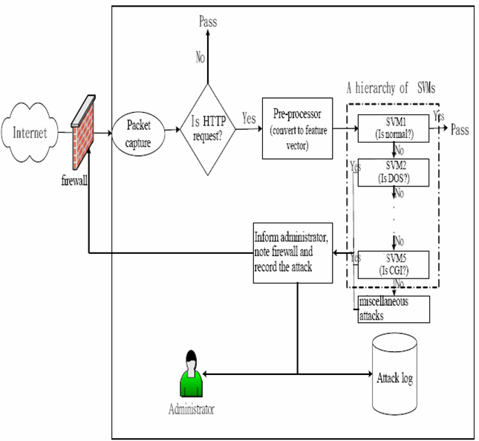
Architecture of NIDS
115/11/08
Department of Computer Science and Information Engineering

Slide 42
Architecture of NIDS
We use an hierarchical architecture to detect the website attacks:
  SVM1 determines whether normal or abnormal.
  SVM2 identifies DOS attack
  SVM3 identifies Unicode attack
  SVM4 identifies Web-based attack
  SVM5 identifies CGI attack
115/11/08
Department of Computer Science and Information Engineering

Slide 43
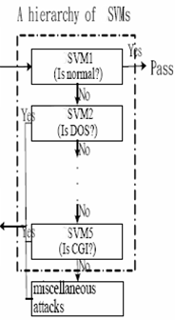
Hierarchy SVMs
Suspect activity
Alert
115/11/08
Department of Computer Science and Information Engineering

Slide 44
Feature vector
An HTTP request is transformed to a 6-element feature vector.
For example,
GET/ecscripts/ecware.exe
↓
(1, 0, 3, 3, 0, 0).
115/11/08
Department of Computer Science and Information Engineering

Slide 45
Feature vector
x₁ is set to 1 if the method is “GET”, 2 if the method is “POST”, or 3 otherwise.
x₂ is set to 1 if the request contains at least one of the listed Unicodes, and 0 else.
  Unicode: %20, %c1, %1c, %c0, %af, %9c`,%2e...
115/11/08
Department of Computer Science and Information Engineering

Slide 46
Feature vector
x₃ is determined by sensitivity of the directory as follows.
  x3 = 1, if directory /cgi-shl, /cgi-win, /cgi-bin, /bin, or /cgi is being accessed.
  x3 = 2, if directory /CFDOCS, /cfdocs, /_vti_pvt, /scripts, /_vti_bin, /_vti_rpc, is being accessed.
x₄ is determined by type of the file as follows.
  x4 = 1, if a html, htm, gif, or jpg is being accessed.
  x4 = 2, if an asp, jsp, js, pl, cfm, log, pwd, php3, ihtml, csc,... is being accessed.
  x4 = 3, if an exe, dll, bat, com, or conf is being accessed.
115/11/08
Department of Computer Science and Information Engineering

Slide 47
Feature vector
x₅ is determined according to some special strings as follows.
  x5 = 1, if “<SCRIPT>” or “alert(document.domain)” appears.
  x5 = 2, if “finger”, “dir”, “newuser”, “../”, “passwd”, “remove”, “xforce”, “root”, “?” or “::$DATA” appears.
  x5 = 3, if “cmd” or “del” appears.
x₆ is set to 1 if request length is more than 100 bytes, and 0 else.
115/11/08
Department of Computer Science and Information Engineering

Slide 48
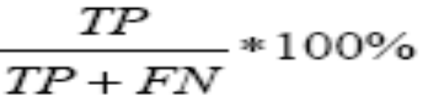
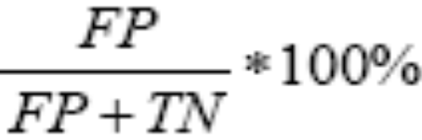
Notations and Evaluation Measures
True Positives rate (TP): It indicates that the detection system detects a attack precisely. defined as
False Positives rate (FP): it indicates that a particular activity was detected as a attack but it is actually regular. Too more FP report will let the administrators to intentionally ignore the detection system warnings. It is defined as
115/11/08
Department of Computer Science and Information Engineering

Slide 49

Notations and Evaluation Measures
Overall Accuracy (OA): Evaluating the detection efficiency of a security system, it is not only considering the higher TP rate but also considering the lower FP rate.
Therefore, the overall accuracy could be the main reference for us to compromise both TP rate and FP rate. It is defined as
115/11/08
Department of Computer Science and Information Engineering

Slide 50
Notations and Evaluation Measures
Cross Validation rate (CV) Rate: We use this to represent the prediction ability of a security system when facing unknown or novel attacks.
115/11/08
Department of Computer Science and Information Engineering
Notes:
Common types of cross-validation
K-fold cross-validation
In k-fold cross-validation, the original sample is randomly partitioned into k equal size subsamples. Of the k subsamples, a single subsample is retained as the validation data for testing the model, and the remaining k − 1 subsamples are used as training data. The cross-validation process is then repeated k times (the folds), with each of the k subsamples used exactly once as the validation data. The k results from the folds then can be averaged (or otherwise combined) to produce a single estimation. The advantage of this method over repeated random sub-sampling is that all observations are used for both training and validation, and each observation is used for validation exactly once. 10-fold cross-validation is commonly used,^{[6]} but in general k remains an unfixed parameter

Slide 51
Experimental Results
Training phase: 1,000 normal and 1,000 abnormal
  The 1,000 abnormal records are composed of 208 DOS, 177 Unicode, 197 Web-based, 220 CGI, and 198 miscellaneous attacks.
Ten-fold cross validation
Get SSVM1, SSVM2, SSVM3, SSVM4, and SSVM5
115/11/08
Department of Computer Science and Information Engineering

Slide 52
Experimental Results
Testing phase: 27,654 HTTP requests
- be composed of 15,517 normal requests and 12,137 anomaly requests.
- There are 1590 DOS, 1144 Unicode, 3786 Web-based, 3752 CGI, and 1865 miscellaneous attacks.
115/11/08
Department of Computer Science and Information Engineering

Slide 53
Known attacks detection: (denoted by EA)
  All attacks are involved in the training phase and testing phase
Unknown attacks detection: (denoted by EB)
  Some category of attack is removed in the training phase, but appear in the testing phase.
115/11/08
Department of Computer Science and Information Engineering

Slide 54
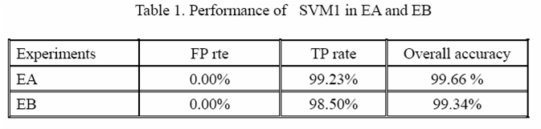
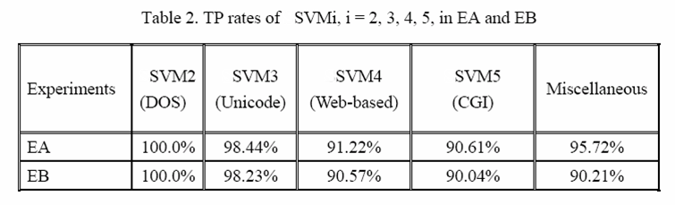
First, the category of miscellaneous attack is removed in the training phase. i.e. in EB, 1865 miscellaneous attacks are removed in the training, but appear in the testing phase
115/11/08
Department of Computer Science and Information Engineering

Slide 55
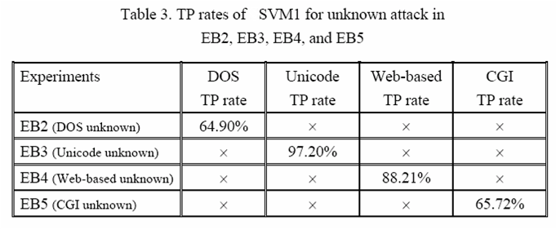
Next, other category is considered.
115/11/08
Department of Computer Science and Information Engineering

Slide 56
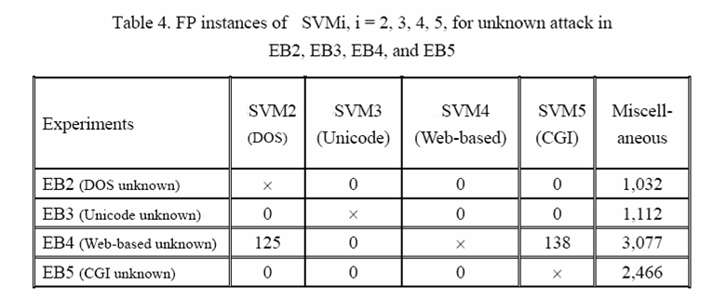
115/11/08
Department of Computer Science and Information Engineering

Slide 57
Conclusion
The kernel of the NIDS is a hierarchy of SVMs that consists of five SVMs.
For the testing set with 27,654 HTTP request packets, the detection rate is 99.23% and false alarm instance is zero.
For unknown detection, the detection rate ranges vary between 64.90% and 97.20%, depending on their signatures variation.
115/11/08
Department of Computer Science and Information Engineering

Slide 58
Outline
Introduction
(The threats to information security and some solutions)
A Brief View of Support Vector Machine
Intrusion Detection System for Web Server Based on Support Vector Machine
Spam Filtering System with Security Mechanism
Surveillance Spyware Detection System
Conclusions
115/11/08
Department of Computer Science and Information Engineering

Slide 59
Introduction
The threat of spam
  80% emails transmitted on the network are spam.
  Deleting spam exhausts 874 dollars for each person per year.
  In June 2004, a survey showed that networks users in Taiwan will receive 42.2 spam and spend 7.94 minutes to deal with them every day.
  Taiwan is the top five area which is harmed by spam. The spam cost us nearly 600 million NTD.
115/11/08
Department of Computer Science and Information Engineering

Slide 60
Introduction
Some other email-relative attack
  Attaching files such as virus, worm or trojan on the email to spread those malicious code out.
  Stealing or modifying the content of email.
  Using a burst of email as a DoS or DDoS attack to break down specific mail server.
115/11/08
Department of Computer Science and Information Engineering

Slide 61
Introduction
In our study, we try to find a solution to filter out the spam as well as possible.
Due to the lack of nowadays rule-based spam filtering packets which have no learning ability to upgrade its filtering mechanism, these packets always have bad filtering results.
Our spam filtering system also integrates with the concepts of support vector machine to get a better classification result on spam. We also compare the spam classification study by using Naïve Bayes and Neural Networks.
115/11/08
Department of Computer Science and Information Engineering

Slide 62
Introduction
To avoiding malicious code which will infect the server to continuously spread out spam or malicious code, our system implements a software firewall to monitor the communication port 25. This software firewall will authenticate all the email software which try to use port 25.
115/11/08
Department of Computer Science and Information Engineering

Slide 63
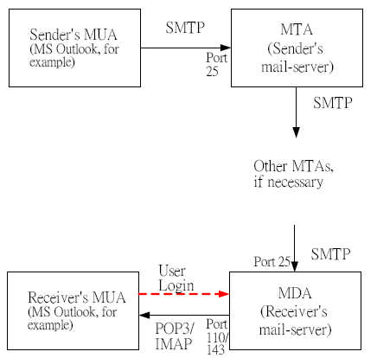
Related works
Framework of email system
115/11/08
Department of Computer Science and Information Engineering
Notes:
MTA就是Mail Transfer Agent，邮件传输代理。就相当于Exchange的集线器传输角色的部分功能。
MUA就是Mail User Agent，邮件用户代理。就是Outlook、foxmail等等一些第三方邮件客户端。
MDA就是Mail Delivery Agent，邮件投递代理。就相当于Exchange的集线器传输角色的部分功能。
综合来讲，MTA和MDA组合起来就相当于Exchange的集线器传输角色了。

Slide 64
Related Works
Since email the widely used by everyone, it becomes a good intermediate for spreading spam and malicious code.
The email with some bad intention usually use the society engineering to cheat user by making some charming topics, containing pornographies or even pretending to be an old friend’s email. Those kind of dirty methods are often useful to cheating users to open the spam or malicious code.
115/11/08
Department of Computer Science and Information Engineering

Slide 65
Related Works
The email-relative attack can be roughly divided into following two categories:
  Email with malicious code：
    Melissa, Love letter which will spread itself according to the email list on the infected machine.
    MyDoom, NetSky, Bagle which will plant the trojan horse on the target machine.
  Spam：
    Mail Bomb.
    Advertisement email
115/11/08
Department of Computer Science and Information Engineering

Slide 66
Related Works
Some of the solutions to spam are listed as follows:
By upgrading the MUA software, for example, fixing the problem of outlook which will automatically preview the received email can avoid executing some malicious code which was embedded in email.
Installing the anti-virus products which can scan the content of email attachments.
115/11/08
Department of Computer Science and Information Engineering

Slide 67
Related Works
Using the email server which is able to control the amount of forwarding emails.
Some software will help users define their own filtering rules to remove the emails they do not want to read.
115/11/08
Department of Computer Science and Information Engineering

Slide 68
Related Works
There are still some issues need to be solved:
The anti-virus software can only detect the known malicious. Once an unknown or novel one comes out, it will become useless to catch the malicious code attached in the email.
115/11/08
Department of Computer Science and Information Engineering

Slide 69
Related Works
The performance of spam filtering software is not good enough and the process of defining filtering rules is too complicate to do well by unsophisticated users.
Most of the spam classification researches are only focus on English email and there still needs more efforts on Chinese email classification.
115/11/08
Department of Computer Science and Information Engineering

Slide 70
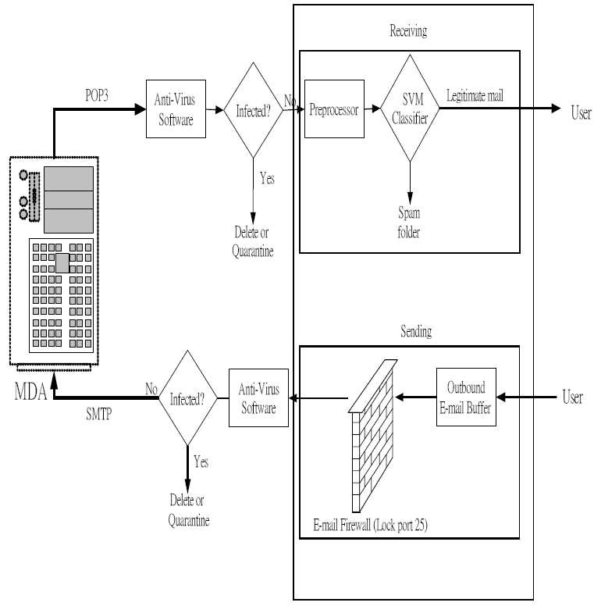
System Architecture
115/11/08
Department of Computer Science and Information Engineering

Slide 71
System Architecture
Our e-mail client system is actually a Mail User Agent (MUA). In addition to sending and receiving e-mail it has the capacities to filter spam message and meanwhile enhance the security.
Instead of substituting anti-virus applications, the MUA can be deployed along with them to fight against worms that use e-mail mechanism to proliferate (or spread).
115/11/08
Department of Computer Science and Information Engineering
Notes:
Proliferate: to spread.

Slide 72
System Architecture
Any e-mail entering the user’s computer is first checked by the installed anti-virus software (if exists).
If the e-mail is infected, it is deleted or quarantined by the anti-virus software. If the e-mail is not infected, our preprocessor module is responsible to convert the e-mail to a feature vector, which contains 108 elements.
115/11/08
Department of Computer Science and Information Engineering

Slide 73
Selected Features
Our system uses 105 feature words which can be divided in three categories:
  General terms in the contents of email
    For example, free, cheap, adult etc.
  Symbols
    ！,＄,％,# etc.
  The contents of an email
    The total numbers of words, the proportion of key words.
115/11/08
Department of Computer Science and Information Engineering

Slide 74
Selected Features
We will convert these features into a SVM vector for training and testing.
A feature vector:
(1, 0, 0, 3, 2, 0, 0, 0, 0, 0, 1, 1, 6, 2, 3, 0, 0, 0, 0, 0, 0, 0, 0, 0, 3, 1,0, 0, 7, 0, 0, 9, 0, 3, 0, 0, 0, 0, 0, 0, 0, 0, 0, 0, 2, 0, 0, 0, 0, 0, 0, 0, 0, 0, 0, 1, 0, 0, 0, 0, 0, 0, 1, 44, 0, 0, 0, 5, 0, 0, 0, 0, 9, 0, 1, 0, 0, 1, 0, 0, 0, 1, 1, 0, 0, 0, 0, 0, 1, 9, 0, 3, 0, 0, 4, 3, 0, 1, 0, 34, 0, 4, 7, 1,0, 579, 175, 0.302245250431779)
579: total words; 175: total keywords
115/11/08
Department of Computer Science and Information Engineering

Slide 75

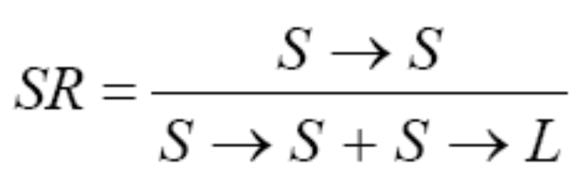
Experimental Results
Usually, a spam filtering approach can be evaluated by two criteria, Spam Precision (SP) and Spam Recall (SR), and they are defined as follows.
where “S” denotes spam message, “L” denotes legitimate mail
115/11/08
Department of Computer Science and Information Engineering

Slide 76
Experimental Results
In the real world, misclassification of legitimate mail is worse than misclassification of spam
So, we use a parameter λ to tune the times of cost of the two misclassifications. Whenλ=1, the misclassification cost is identical for both legitimate and spam errors. When λ is set to 9, the cost of misclassifying a legitimate mail is increased to nine times larger than that of misclassifying a spam.
115/11/08
Department of Computer Science and Information Engineering

Slide 77
Experimental Results
We used The famous Ling-Spam Corpus [14] consists of 2,412 legitimate e-mails and 481 spam messages to train our SVM model.
When λ was set to 9, our SP reached to 100%, better than Boosting Tree’s 99.35%, although our SR, 87.54%, was not as good as Boosting Tree’s 94.80%.
115/11/08
Department of Computer Science and Information Engineering
Notes:
C4.5演算法是ID3演算法的修訂版 ，採用GainRatio來加以改進方法，選取有最大GainRatio的分割變數作為準則，避免ID3演算法過度配適的問題。
C5.0演算法則是C4.5演算法的修訂版，適用在處理大資料集，採用Boosting方式提高模型準確率，又稱為Boosting Trees

Slide 78
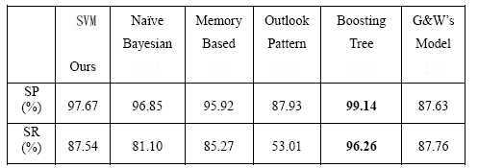
Experimental Results
λ=1
115/11/08
Department of Computer Science and Information Engineering
Notes:
Memory Based K-NN

Slide 79
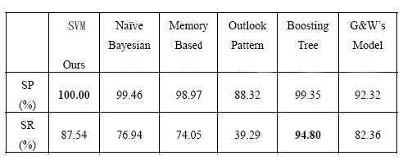
Experimental Results
λ=9
115/11/08
Department of Computer Science and Information Engineering

Slide 80
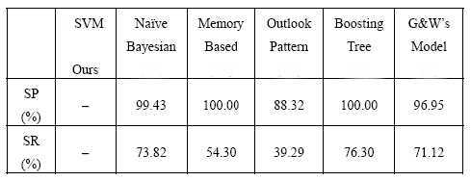
Experimental Results
λ=999
115/11/08
Department of Computer Science and Information Engineering

Slide 81
Conclusion
Since there are the text-only contents of spam in the Ling-Spam dataset, we can not get more features on the mail titles, senders or attachments to define the spam more precisely. If we can use those kinds of features, we may get a powerful classifier.
115/11/08
Department of Computer Science and Information Engineering

Slide 82
Conclusion
We had tried to do some Chinese Spam classification, but no standard dataset and the complexity of Chinese are the primal issues.
Considering the relationship between keywords may be an good way to get more features form spam.
115/11/08
Department of Computer Science and Information Engineering

Slide 83
Outline
Introduction
(The threats to information security and some solutions)
A Brief View of Support Vector Machine
Intrusion Detection System for Web Server Based on Support Vector Machine
Spam Filtering System with Security Mechanism
Surveillance Spyware Detection System
Conclusions
115/11/08
Department of Computer Science and Information Engineering

Slide 84
Spyware vs. Virus
Spyware and viruses are completely different threats.
  Action
  Propagation
  Size
  Motivation
  Threshold of creation and obtainment
115/11/08
Department of Computer Science and Information Engineering
Notes:
Actions : collect demographic and personal information, display pop-up advertisements, track shopping and surfing habits or control your computer remotely.
病毒會快速的自我擴散，spyware通常是以欺騙的手法讓使用者執行
病毒小，功能簡單，方便擴散。Spyware大，功能多
病毒：就是要破壞，spyware：不以破壞為主，背後通常有其他動機，例如：政治上，經濟上等等，且因其動機可為善惡。
病毒：製作門檻高，取得不易。Spyware門檻低，取得易。本論文實驗集全部從網路上下載取得，共407支。

Slide 85
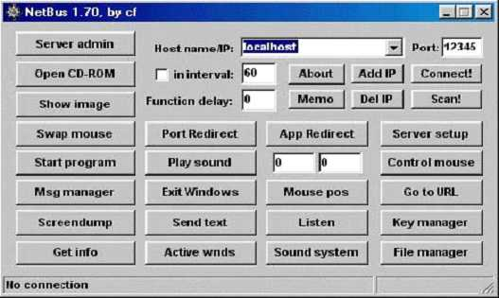
Classes of Spyware
Advertising spyware
  Adware
  Browser hijackers
  Porn Dialers
Surveillance spyware
  Trojan Horses
  Backdoor
  Key loggers
In our study, we focus on surveillance spyware which is much dangerous than advertising one and propose a surveillance spyware detection system (SSDS) to solve the spyware issue.
115/11/08
Department of Computer Science and Information Engineering
Notes:
1. 紀錄瀏覽習慣，不斷寄送廣告信或是跳出廣告視窗。
2. 更改瀏覽器的設定， 導向其他網站，或是修改瀏覽器的見面等等。
3. 色情電話網站撥接
4. 後門
5. 鍵盤記錄器
6. 本論文的主題是監視型間諜程式的偵測。
remote administration type
file server trojan
password sending trojans
key logger trojans;
DDoS trojan

Slide 86
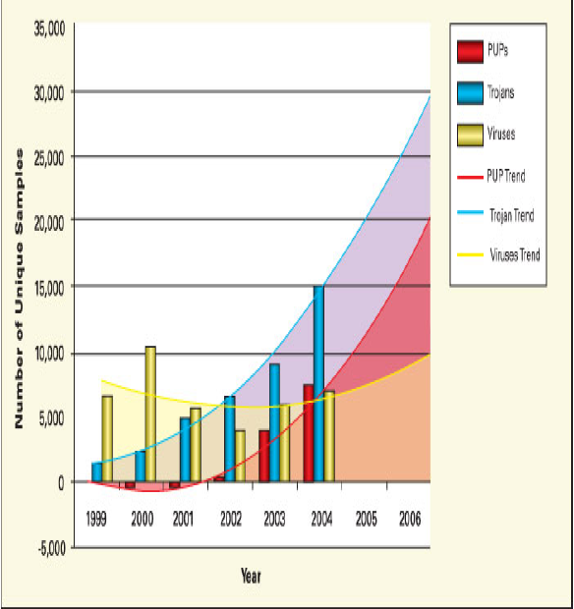
Spyware [15] (cont.)
115/11/08
Department of Computer Science and Information Engineering
Notes:
PUPS是間諜軟件的統稱

Slide 87
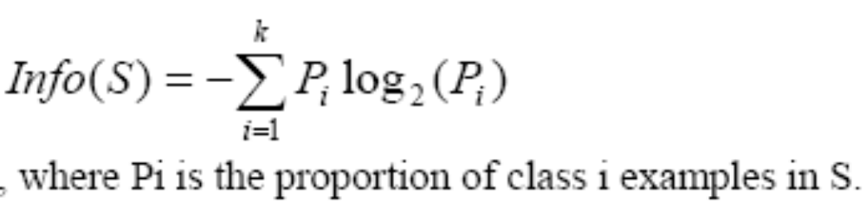
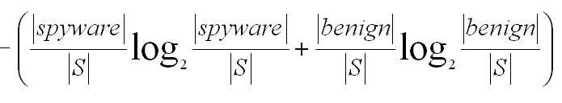
Information Gain [16]
Information: Although we had seen the benefits of SVM, it is a pre-training machine learning mechanism which is not flexible enough. The process of feature selection is the main problem to train a good SVM model. To overcome this problem, we use information gain for feature selection at first.
115/11/08
Department of Computer Science and Information Engineering

Slide 88
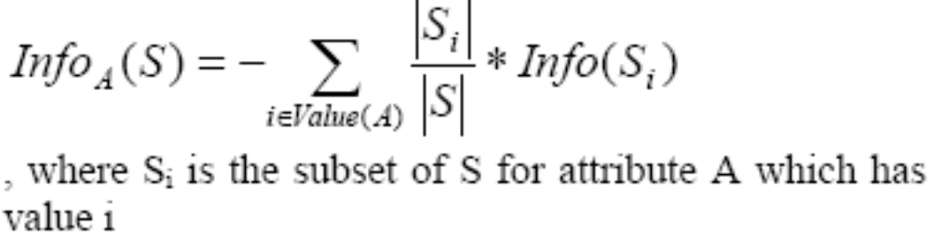
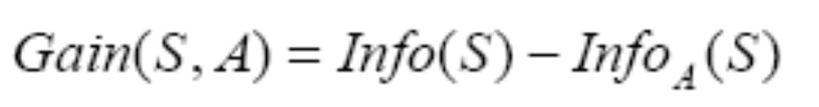
Information Gain
For example, A ={kernel32.dll, user32.dll,… }
By the definition above, we should choose the feature that gives the large information gain value.
115/11/08
Department of Computer Science and Information Engineering

Slide 89
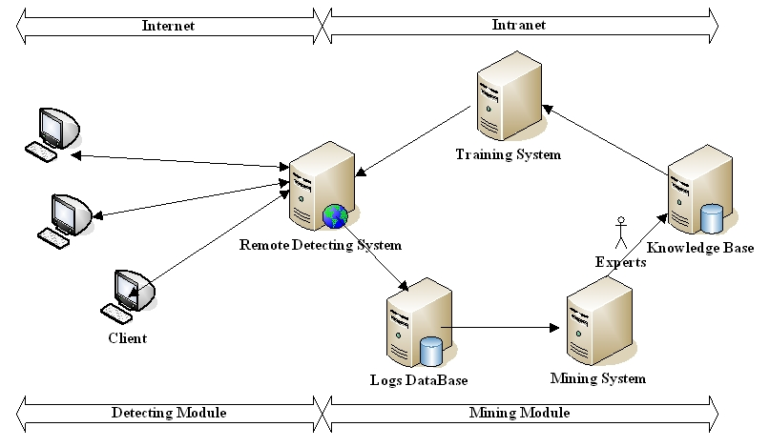
Organization of SSDS
115/11/08
Department of Computer Science and Information Engineering

Slide 90
Organization of SSDS
Our system architecture is composed by two main components, the detection module and data mining module.
SSDS not only has both high detecting rate and predicting rate, but also can continuously upgrades its ability for detecting the changing spyware.
115/11/08
Department of Computer Science and Information Engineering

Slide 91
Detection Module
The detection module consists of local detection part and remote detection part.
The local detection system provides a simple and real-time way for the client to identify whether the incoming executable is a spyware program or not.
115/11/08
Department of Computer Science and Information Engineering

Slide 92
Detection Module
The remote detection system also has the latest SVM classification model which the client can invoke it via internet.
Our detection module has two particular capabilities, the information reporting and remote detection.
115/11/08
Department of Computer Science and Information Engineering

Slide 93
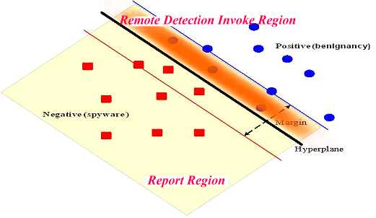
Report region & invoke remote detection region
115/11/08
Department of Computer Science and Information Engineering

Slide 94
Report region
To upgrade the detection ability of our detection module continuously, we should extract more characteristics of spyware through comprehending them.
If an executable was judged as a spyware or benign one whose feature vector falls into the positive side of SVM margin, that is, in the area called “report region”.
115/11/08
Department of Computer Science and Information Engineering

Slide 95
Remote detection
Through the XML Web Service, the server site SVM detection module can be automatically invoked when the executable is suspected.
The server-site SVM will be much stronger to detect the spyware precisely. This mechanism solves the problem that people often forget to update their anti-virus software and provides best protection all the time.
115/11/08
Department of Computer Science and Information Engineering

Slide 96
Mining Module
The mining module is a server-side system which extracts the data in the log database to get useful features to train new SVM classier and record the information about the features, parameters of SVM into the knowledge base.
This feedback procedure can upgrade the ability of detecting spyware continuously.
115/11/08
Department of Computer Science and Information Engineering

Slide 97
Feature vector
We try to collect some information about the incoming executable in three categories which include spyware behaviors, the effect on system files, the activity of network communications and some other tricky information.
115/11/08
Department of Computer Science and Information Engineering

Slide 98
Feature vector
It would be much quicker and useful to identify the behaviors of a spyware program by analyzing the information of the Dynamically Linked Library (DLL) and Win32 API from the import section (.idata section) of PE format[17,18].
With the help of the PE format static analysis, we can figure out the behaviors of the executable before it is executed.
115/11/08
Department of Computer Science and Information Engineering

Slide 99
Feature vector
After running the executable, we record all the modifications which were done by the executable to the system.
We can recognize the effect of executable behaviors upon the system more precisely to reduce the insufficient information of static analysis.
115/11/08
Department of Computer Science and Information Engineering

Slide 100
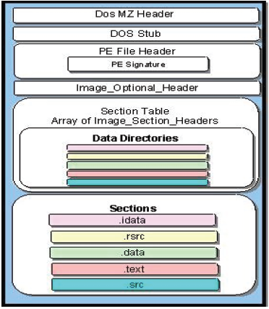
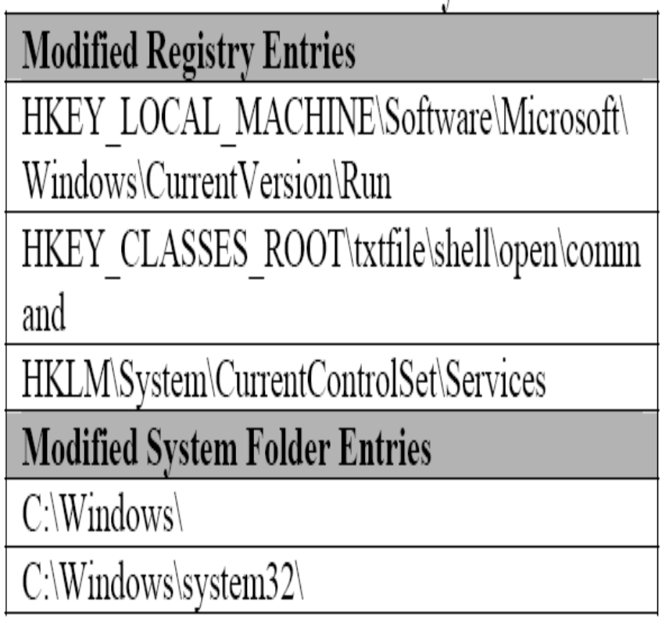
Feature vector
115/11/08
Department of Computer Science and Information Engineering

Slide 101
Feature vector
Since the information gain of static features is less than 0.2. After several tries, we selected 67 features with gain value greater than 0.09 to train the SVM model.
In the dynamic analysis, we select 14 dynamic features with gain value more than 0.05 to train a SVM model.
115/11/08
Department of Computer Science and Information Engineering

Slide 102
Feature vector
After a series of experiment, we finally take 81 features (67 static features and 14 dynamic features) to train our SVM model which will have the best performance.
115/11/08
Department of Computer Science and Information Engineering

Slide 103
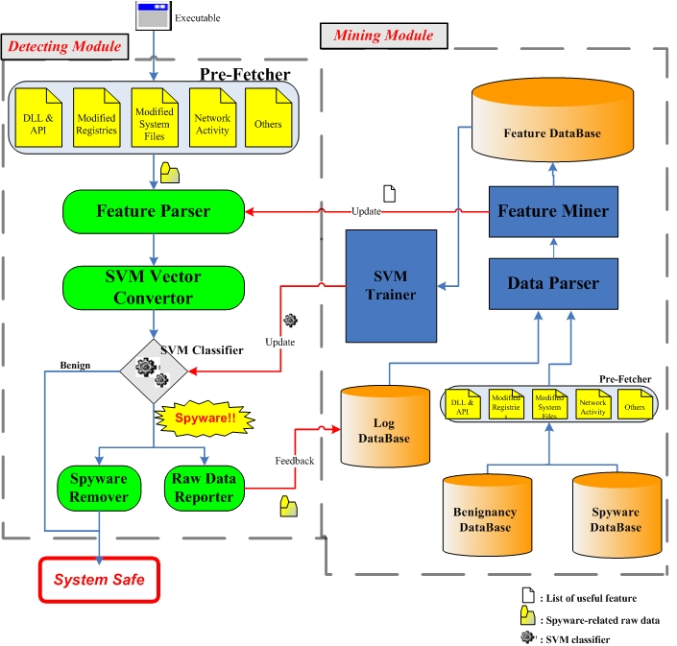
Architecture of SSDS
115/11/08
Department of Computer Science and Information Engineering

Slide 104
Experiment Data Set
As there is no standard experimental data set, we had custom built data set collected from internet during Jan, 2005 to June, 2005 .Our experimental custom built data set consists of 740 benign programs and 407 spyware programs.
115/11/08
Department of Computer Science and Information Engineering

Slide 105
Experiment Data Set
For tallying with the generality of user experience, we chose the benign programs with size similar to spyware programs from five categories, including system tools, business programs, internet applications, multimedia and drafting software.
All the benign programs were downloaded from the web site http://toget.pchome.com.tw which is famous for software sharing.
115/11/08
Department of Computer Science and Information Engineering

Slide 106
Experiment Data Set
We also collected all the spyware from these websites [19, …, 25] most of them are the hacker web forums in Mainland China.
115/11/08
Department of Computer Science and Information Engineering

Slide 107
Experiment Results
 | FP rate | TP rate | OA rate | CV rate
Static | 20.81% | 86.49% | 81.69% | 80.99%
Dynamic | 1.89% | 89.99% | 95.20% | 93.12%
SSDS | 0.68% | 95.33% | 97.91% | 96.43%
 | OA rate | Prediction rate
Kaspersky | 95% | None (*)
Norton | 92% | None (*)
Pccillin | 91% | None (*)
Nod32 | 88% | None (*)
SSDS | 97.91% | 96.43%
115/11/08
Department of Computer Science and Information Engineering

Slide 108
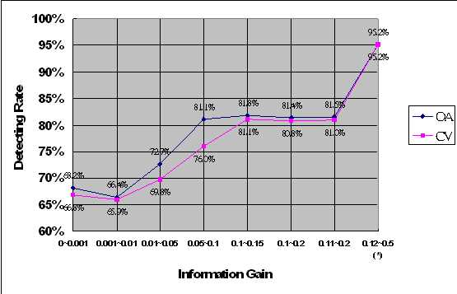
Relation between information gain & detecting rate
115/11/08
Department of Computer Science and Information Engineering

Slide 109
Summarize
We can only make sure of that the feature with higher gain value will improve the performance of SVM model, but it is not the only thing that will affect the performance.
Features with lower or slightly increasing gain value will not sufficiently improve the performance of SVM model.
115/11/08
Department of Computer Science and Information Engineering
Notes:
There are so many factors such as the selection of SVM training parameters, the number of features for training the SVM model and the elements of training set etc.

Slide 110
Contributions
1. Integrate SVM with the information gain which could be a reference for us to decide the feature will be helpful for improving the performance of SVM.
2. We proposed a system that can effectively detect the spyware even an unknown or novel.
3. We proposed an architecture that can continuously upgrade the ability of spyware detection.
115/11/08
Department of Computer Science and Information Engineering

Slide 111
Outline
Introduction
(The threats to information security and some solutions)
A Brief View of Support Vector Machine
Intrusion Detection System for Web Server Based on Support Vector Machine
Spam Filtering System with Security Mechanism
Surveillance Spyware Detection System
Conclusions
115/11/08
Department of Computer Science and Information Engineering

Slide 112
Conclusions
We have tried to combine the data mining and machine learning concepts with information security system.
The prediction ability for detecting unknown or novel attack is not only a dream but a essential and practical base of a security system.
115/11/08
Department of Computer Science and Information Engineering

Slide 113
Conclusions
With our experiment results, we have proven that SVM is an suitable mechanism which can be applied to solve the problems of website intrusion, spam and spyware.
115/11/08
Department of Computer Science and Information Engineering

Slide 114
Conclusions
Feature selection is an important criterion for attack activity definition. We have used information gain as a way to selecting meaningful feature to train our SVM detecting module. But there are still many other ways of doing feature selection.
115/11/08
Department of Computer Science and Information Engineering

Slide 115
Conclusions
The next step of our research will focus on the effect on the combination of different feature selection and classification methods. We will try our best to find the best solution for different security issue.
115/11/08
Department of Computer Science and Information Engineering

Slide 116
Conclusions
Although SVM works well in security system, rule-based mechanism is still an essential way to mitigate the threat of security attacks directly.
Therefore, we will try to combine all our systems to other commercial products such as antivirus software or firewall tightly to get an integrated system with best performance.
115/11/08
Department of Computer Science and Information Engineering

Slide 117
Reference
Snort, http://www.snort.org/
Verwoerd. T and Hunt. R., “Intrusion detection techniques and approaches, Computer Communications”, Volume 25, Issue 15, 2002,pp 1356-1365.
Li Zhi-Tang ; Li Jia-Chun, “Application of fuzzy neural networks to intrusion detection,” Mini-Micro Systems, Volume 23, Issue 10,2002, Pages 1235-1238
The Radicati Group, Inc., http://www.radicati.com/
Spam Statistics, http://bloodgate.com/spams/stats.html
W. W. Cohen, “Learning rules that classify e-mail”, Proceedings of the AAAI Spring Sym. in Information Access, 1999.
I. Androutsopoulos, J. Koutsias, G. Paliouras, K. V. Chandrinos, and C. D. Spyropoulos, “An Evaluation of Naive Bayesian Anti-Spam Filtering”, Proc. of the 11th European Conf. on Machine Learning, Barcelona, Spain, pages 9-17, 2000.
115/11/08
Department of Computer Science and Information Engineering

Slide 118
Reference
B. Massey, M. Thomure, R. Budrevich, and S. Long, “Learning Spam: Simple Techniques for Freely-Available Software”, Proc. of the Usenix Annual Technical Conf., 2003.
EarthLink Inc., “EarthLink Spy Audit,” www.earthlink.net/about/press/pr_spyAudit/.
Pest Patrol, Minimizing Liability and Productivity Risks, A PestPatrol, Inc. Business White Paper.
Stefan Saroiu, Steven D. Gribble, and Henry M.Levy, “Measurement and Analysis of Spyware in a University Environment,” Proceedings of the 1st Symposium on Networked Systems Design and Implementation (NSDI), San Francisco, CA, March 2004.
V. Vapnik, “Statistical Learning Theory, John Wiley and Sons,” New York, 1998.
115/11/08
Department of Computer Science and Information Engineering

Slide 119
Reference
CERT/CC, Emergency Response Team and Coordination Center (reporting center for internet security problems), http://www.cert.org/.
Ling-Spam Training Corpus, Internet Content Filtering Group, http://www.iit.demokritos.gr/skel/i-config/
McAfee, Potentially Unwanted Programs, AVERT Technical White Papers
http://vil.nai.com/vil/white-paper.asp
J. R. Quinlan, “Induction of decision trees”, Machine Learning, 1, 1986.
Matt Pietrek, “An In-Depth Look into the Win32 Portable Executable File Format,” MSDN Magazine, March 2002
115/11/08
Department of Computer Science and Information Engineering

Slide 120
Reference
Microsoft Corporation, “Portable Executable Formats,” Formats specification for Windows.
Spyware Webstie, http://mmbest.com/index.html
Spyware Webstie, http://www.kobayashi.cjb.net/
Spyware Webstie, http://www.xfocus.net/index.html
Spyware Webstie, http://www.hf110.com/Index.html
Spyware Webstie, http://www.hacker365.com/down.asp
Spyware Webstie, http://www.eqla.demon.co.uk/trojanhorses.html
Spyware Webstie, http://www.ttian.net
115/11/08
Department of Computer Science and Information Engineering

Slide 121
Q & A
Thank you !
115/11/08

